Slide 1
Key Concepts of Object Oriented Programming
Pillars and key concepts of object-oriented development

Slide 2
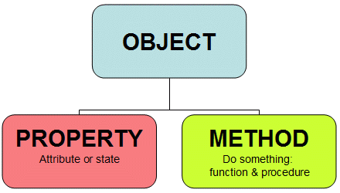
Objects
Basic run-time entities in an object-oriented system
They may represent a person, a place, a bank account, a table of data or any item that the program must handle.
Program objects should match closely with the real-world objects.
Objects take up space in the memory and have an associated address
When a program is executed the objects interact by sending messages to one another.

Slide 3
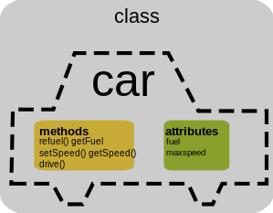
Classes
The entire set of data and code of an object
An object can be made a user-defined data type through a class
Once a class has been defined, any number of objects belonging to that class can be defined
A class is a collection of objects of similar type.
Classes are user-defined data types, very much like the built-in types of programming language.

Slide 4
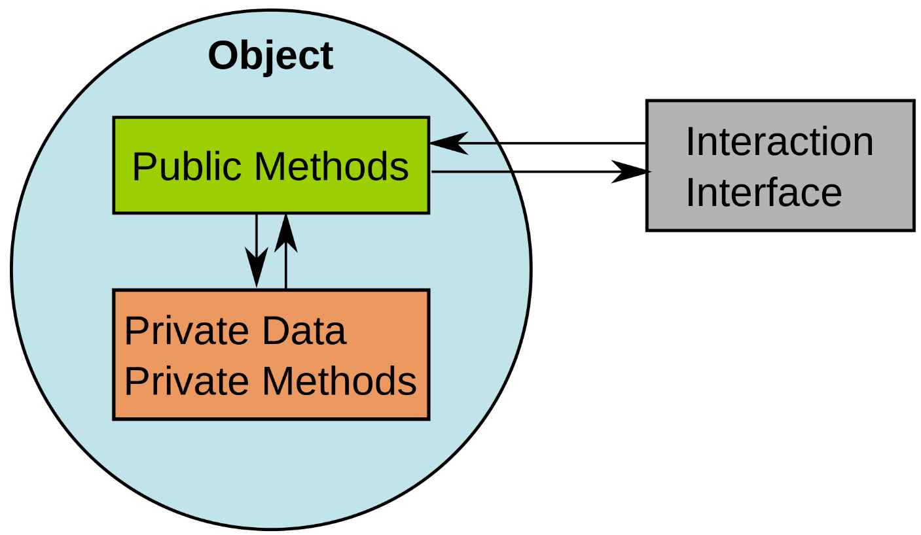
Encapsulation
The wrapping up of data and functions into a single unit
The data is not accessible to the outside world
Only those functions which are wrapped in the class can access it
The insulation of the data from direct access by the program is called data hiding or information hiding.

Slide 5
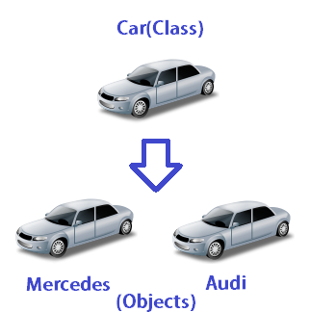
Data Abstraction
The act of representing essential features without including the background details or explanations.
Classes use the concept of abstraction
Defined as a list of abstract attributes such as size, weight and cost
Functions operate on these attributes.
Known as Abstract Data Types.

Slide 6
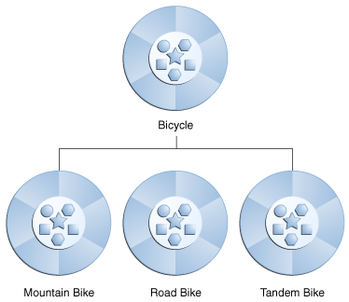
Inheritance
Object of one class assume the properties of another class
Each derived class shares common characteristics with the parent class
Provides reusability
Can add additional features to an existing class without modifying it
Goes hand-in-hand with abstraction

Slide 7
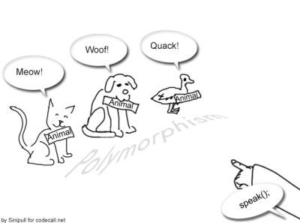
Polymorphism
Ability to take more than one form
An operation may exhibit different behaviours in different instances
Behaviour depends upon the types of data used in the operation
Example : operation of addition
For numbers, addition will generate a sum – 4 + 6 = 10
For two words, addition would produce a concatenated word – “can” + “not” = “cannot”
Making an operator exhibit different behaviours in different instances is known as Operator Overloading
Using a single function name to perform different tasks is known as function overloading.

Slide 8

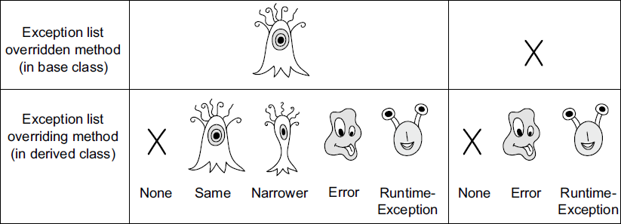
Polymorphism Continued
Overloading
Two methods with the same name, but different signatures.
Overloading is resolved at compile time.
Defines polymorphism.
Overriding
Redefine a method from a parent class.
Exact same signature.
Overriding is resolved at run time.

Slide 9
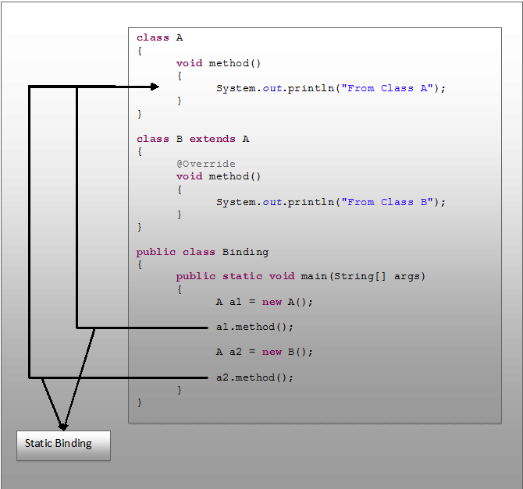

Dynamic Binding
Static Binding
Linking a procedure call to the code to be executed in the call’s
The code associated with a given procedure call is not known until run-time
Associated with polymorphism and inheritance.
Also known as late binding
Contrast with early or static binding which happens at compile time
Dynamic Binding

Slide 10
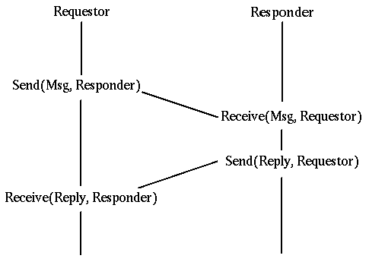
Message Communication
An object oriented program consists of a set of objects that communicate with each other.
Objects communicate with one another by sending and receiving information much that same way as people pass messages to one another.
Message passing involves specifying the name of the object, the name of the function (message) and the information to be sent.
emp.salary(emp_name)

Slide 11
References
Key Concepts to learn in Object Oriented Programming – codingsec.net

